Slide 1

Java Programming
Java Fundamentals
Java基础知识

Slide 2
Outline
Variables and Types
Operators and Expressions
Control Structures (Omitted)
Static Methods
Arrays

Slide 3
Variables and Types

Slide 4
Variable declaration statement
We must declare the variables before use them.
Syntax
type varName;
type varName1, varName2;
Note: in multiple-variable declaration, the names are separated by commas (,).

Slide 5
Identifiers(标识符)
Identifiers can be used to name classes, variables, and subroutines.
It must begin with a letter(e.g. a-zA-Z) or underscore character(_) or dollar sign character ($)
The convention, however, is to always begin your variable names with a letter, not "$" or "_"
And it must consist entirely of letters, digits, underscores, and dollar signs($).
Identifiers are case-sensitive!

Slide 6
Name Convention(命名惯例)
When choosing a name for your variables, use full words instead of abbreviations.
If the name you choose consists of only one word, spell that word in all lowercase letters.
If it consists of more than one word, capitalize the first letter of each subsequent word (camel-case).
Notes:
camel-case驼峰式命名法

Slide 7
Identifiers(标识符)
Some legal identifiers:
N i j
student_name studentName StudentName
$money _student_id
Some illegal identifiers:
8N #i @point &address
package void class public

Slide 8
Keywords(关键词)
Keywords are the words preserved by Java, which are used by the compiler to analyze the structure of the program.
Keywords are not allowed to use as identifiers.
In the Hello.java, the keywords include package, public, class, static, void, and int.

Slide 9
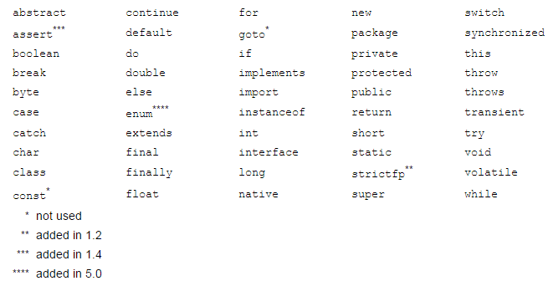
Keywords
You can find the complete list of keywords at http://docs.oracle.com/javase/tutorial/java/nutsandbolts/_keywords.html

Slide 10
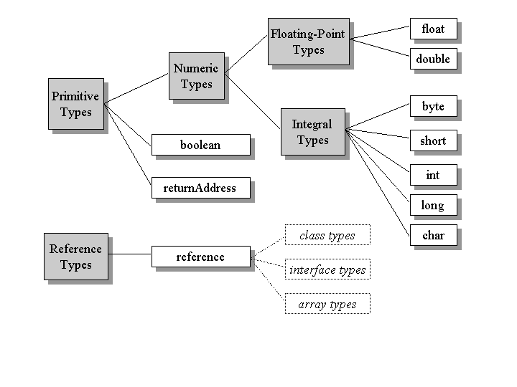
Types

Slide 11
Primitive Types(基本数据类型)
There are 8 primitive types built into Java:
byte, short, int, long, float, double, char, and boolean.
For example:
boolean: Truth value (true or false).
int: Integer (0, 1, -47).
double: Real number (3.14, 1.0, -2.1).

Slide 12
Primitive Types
byte holds 8 bits
Value range: -128 and 127
short, two bytes (16 bits)
Value range: -32768 to 32767.
int, four bytes (32 bits)
Value range: -2147483648 to 2147483647.
long, eight bytes (64 bits)
Value Range: -9223372036854775808 to 9223372036854775807.

Slide 13
Primitive Types
float, 4 bytes, 7 significant digits
Value range: (+/-) 1.4E-45 to 3.4028235E38
double, 8 bytes, 15 significant digits
Value range: (+/-) 4.9E-324 to 1.7976931348623157E308
char, 2 bytes
A single character from traditional ASCII character or Unicode characters that come from different languages.
Value range: 0 to 65535
boolean, ? bytes
true or false
Notes:
为什么boolean存储空间大小不确定？
A char is a single character, that is a letter, a digit, a punctuation mark, a tab, a space or something similar.
A char literal is a single one character enclosed in single quote marks, e.g. 'g' .

Slide 14
A reference type: String
String is a type, but not a primitive type; it is in fact the name of a class which we will introduce in future lectures.
A value of type String is a sequence of characters. We’ve already seen a string value: "Hello World!"

Slide 15
Assignment(赋值)
Use = to give variables a value.
String foo, story;
foo = “My name is Tom, I’m 7 years old.”;
story= “Tom said:\”I like Java!\””;
Can be combined with a variable declaration.
double Pi = 3.14;
boolean isJanuary = true;
Notice:
Variables must be initialized (assigned for the first time) before they can be used.

Slide 16
Literals(字面常量)
A literal is something that you can type in a program to represent a value.
It is a kind of name for a constant value.

Slide 17

Literals
int a = 45, b = 045, c = 0x45, d = 0XFF1A;
int x = 0b110, y=0B110;
float a = 1.0, b = 1.0f, c = 1.3e12F, d = 1.3E-12F;
double a = 1.0, b = 12.3737e-108;
char a = ’a’, b = ’\n’, c = ’\u00E9’;
boolean a = true, b = false;
String a = “a”, b = “Hello world!”;
Notes:
045是八进制
For general-purpose programming, the decimal system is likely to be the only number system you'll ever use. However, if you need to use another number system, the following example shows the correct syntax. The prefix 0x indicates hexadecimal and 0b indicates binary
he floating point types (float and double) can also be expressed using E or e (for scientific notation), F or f (32-bit float literal) and D or d (64-bit double literal; this is the default and by convention is omitted).

Slide 18
Notice
Any numeric literal that contains a decimal point or exponential is a literal of type double.
To make a literal of type float, you have to append an “F” or “f” to the end of the number.
The single quotation marks and double quotation marks are not part of the actual value!
Must use English punctuation marks!

Slide 19
Conversion by casting(转换)
int a = 18; // correct
double = 18.7; // correct
int a = 18.7; // compile error
int a = (int)18.7; // a = 18 (Explicit casting)
double a = 2; // a = 2.0 (Implicit, legal but bad)

Slide 20
Conversion by casting
Implicit casting (widening conversion)
A data type of lower size is assigned to a data type of higher size.
This is done implicitly by the JVM. The lower size is widened to higher size.
This is also named as automatic type conversion.

Slide 21
Conversion by casting
Explicit casting (narrowing conversion)
A data type of higher size cannot be assigned to a data type of lower size. Otherwise , it will raise a compilation error "possible loss of precision".
This is not done implicitly by the JVM and requires explicit casting; a casting operation to be performed by the programmer.

Slide 22
Conversion by casting
“size” of primitive types
byte < short < int < long < float < double
Note:
Casting between char and short
The char and short, each takes 2 byte of memory.
Either char to short or short to char requires explicit casting.
A boolean value cannot be assigned to any other data type.

Slide 23
Comments(注释)
Comments in a program are entirely ignored by the computer; they are there for human readers only. There are two types of comments.
Single line comment
begins with // and extends to the end of a line.
Multiple lines comment
starts with /* and ends with */
Javadoc comment
begins with /**(two stars) and end with */ (one star).
Notes:
“Javadoc” comment can be used to produce documentation for the program.

Slide 24
Operators and Expressions

Slide 25
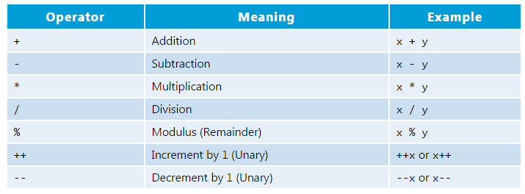
Arithmetic Operators(算术运算符)
Symbols that perform simple computations.
Note: Division (“/”) operates differently on integers and on doubles!

Slide 26
Overflow and Underflow(上溢下溢)
int overflow = 2147483647;
System.out.println("Overflow: "+ (overflow + 1));
int underflow = -2147483648;
System.out.println("Underflow: "+ (underflow - 1));
double d = 1e308;
System.out.println(d + "*10= " + d*10);
d = 1e-320 * Math.PI;
System.out.println(" " + (d / 100000));
Notice: Overflow or underflow never throw a run time exception!

Slide 27
Overflow and Underflow(上溢下溢)
System.out.println(“1.0/0=”+ 1.0/0);
System.out.println(“0.0/0=”+ 0.0/0);
System.out.println(“1/0=”+ 1/0);
Notice:
Infinity represents The result of dividing a float or double number by zero
NaN represents Not a Number
Do not use NaN and Infinity in the arithmetic operation!
Notes:
Infinity
NaN
ArithmeticException

Slide 28
Rounding errors(舍入错误)
The difference between the number we want and the floating-point number we get is called rounding error.
System.out.println(0.1 + 0.1 + 0.1 + 0.1 + 0.1 + 0.1 + 0.1 + 0.1 + 0.1 + 0.1);
On many machines, the output is 0.9999999999999999

Slide 29
Order of Operations
Precedence like math, left to right
Multiplication and division precede over Addition and subtraction
Parenthesis increase precedence
Example:
double x = 3 / 2 + 1; // x = 2.0
double y = 3 / (2 + 1); // y = 1.0
Notes:
Operator Precedence

Slide 30
String concatenation(连接) operator
float r = 12.0F;
String str = “The circular area with radius ”;
str = str + r + “ is: ”;
str = str + 3.1415926*r*r;

Slide 31
CalcArea.java
package hit.edu.java.intro;
public class CalcArea {
public static void main(String[] arguments) {
float r = 12.0F;
String str = “The circular area with radius ”;
str = str + r + “ is: ”;
str = str + 3.1415926*r*r;
System.out.println(str);
}
}

Slide 32
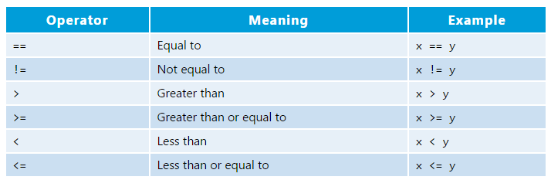
Relational operators
Relational operators are used to check conditions like whether two values are equal, or whether one is greater than the other.

Slide 33

Notice
Do not use rational operators to compare reference type data, e.g. Strings.

Slide 34
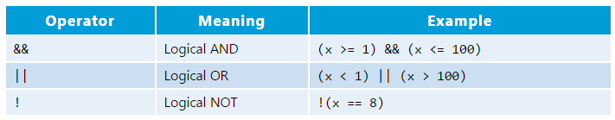
Logical operators
Note: 1<= x <=100 //this is wrong!
Example:
boolean A=true, B=false, C=true;
System.out.println(A && (B || C));

Slide 35
Static Methods

Slide 36
Adding new Static Method
So far we’ve only written short programs that have a single class and a single method (main).
Can we calculate the radians or degrees by calling the methods that are defined by ourselves?

Slide 37
Static method definition
public static TYPE MethodName (TYPE Parameter) { STATEMENTS [return EXPRESSION;] }

Slide 38
RadianAndDegree.java
package edu.hit.java.intro;
public class RadianAndDegree {
public static double toRadians(double degree) {
double radian = degree*3.1415926/180.0;
return radian;
}
public static double toDegrees(double radian) {
double degree= radian*180.0/3.1415926;
return degree;
}
public static void main(String[] args) {…}
}

Slide 39
RadianAndDegree.java
public static void main(String[] args) {
double d = toRadians(180.0);
System.out.println(d);
double r = toDegrees(3.1415926);
System.out.println(r);
}

Slide 40
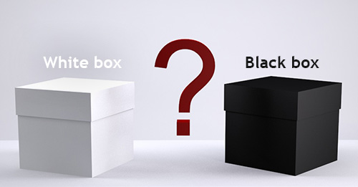
“black box”
A method is sometimes said to be a “black box”
A black box needs some kind of interface with the rest of the world, which allows some interaction between what’s inside the box and what’s outside.
To use a black box, you shouldn’t need to know anything about its implementation; all you need to know is its interface.
The interface of a black box should be fairly straightforward, well-defined, and easy to understand.
Notes:
The interface of a black box should be fairly straightforward, well-defined, and easy to understand.

Slide 41

“black box”
public static double calcBMI(double m, double kg) {
return kg/(m*m);
}
Anecdote: A unit confusion between pounds and newtons led to the loss of NASA's $94 million Mars Climate Orbiter.

Slide 42

“contract”
The interface also includes a specification of what the box does and how it can be controlled by using the elements of the interface.
we can refer to both parts of the interface—syntactic and semantic —collectively as the contract of the method.
A convenient way to express the contract of a subroutine is in terms of preconditions and postconditions.

Slide 43
Preconditions & postconditions
A precondition(前置条件) of a subroutine is something that must be true when the subroutine is called, if the subroutine is to work correctly.
For example,
for the built-in function Math.sqrt(x), a precondition is that the parameter, x, is greater than or equal to zero, since it is not possible to take the square root of a negative number.

Slide 44
Preconditions & postconditions
A postcondition(后置条件) is something that will be true after the subroutine has run (assuming that its preconditions were met—and that there are no bugs in the subroutine).
For example,
the postcondition of the function Math.sqrt() is that the square of the value that is returned by this function is equal to the parameter that is provided when the subroutine is called.

Slide 45
Preconditions & postconditions
Methods are sometimes described by comments that explicitly specify their preconditions and postconditions.
The comments are given in the form of Javadoc comments, but we can explicitly label the preconditions and postconditions.

Slide 46
Javadoc comments
begins with /** and ends with */
Javadoc comments can be used to describe methods, member variables, and classes. And they always immediately precede the thing it is commenting on.
There is a tool called javadoc that reads Java source code files, extracts any Javadoc comments that it finds, and creates a set of Web pages which can help us to understand how to use the methods.

Slide 47
Javadoc comments
There are many tags which can help the javadoc tool to create nicely formatted, interlinked web pages from the Javadoc comments.
Some frequently used tags are as follows:
@author
@version
@param
@return

Slide 48
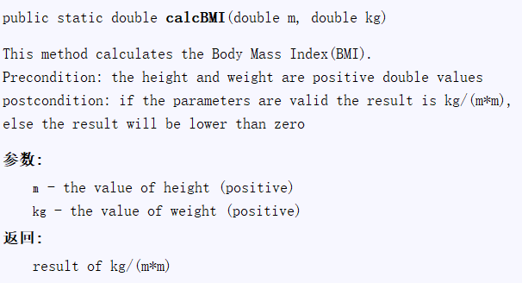
Javadoc comments
/**
* This method calculates the Body Mass Index(BMI).
* Precondition: the height and weight are positive double values
* postcondition: if the parameters are valid the result is kg/(m*m),
* else the result will be lower than zero
* @param m the value of height (>0)
* @param kg the value of weight (>0)
* @return result of kg/(m*m) */
public static double calcBMI(double m, double kg) {
if(m<=0 || kg<=0) return -1;
return kg/(m*m);
}

Slide 49
Quiz1: Fibonacci sequence
Fibonacci sequence
1 1 2 3 5 8 13 …
Write a class with a method named fibonacci to print the fibonacci sequence
In the main method, invoke the fibonacci method

Slide 50
Arrays

Slide 51
Create an array
To create an array of a given size, use the operator new.
int[] values = new int[5];
or
int values[] = new int[5];
or you may use a variable to specify the size:
int size = 12;
int[] values = new int[size];
Note: When you create an array of ints, the elements are initialized to zero.

Slide 52
Array Initialization(数组初始化)
Curly braces can be used to initialize an array. It can ONLY be used when you declare the variable.
int[] values = new int[]{ 12, 24, -23, 47 };
or
int[] values = { 12, 24, -23, 47 };
Is there an error in this code?
int[] values = {1, 2.5, 3, 3.5, 4};

Slide 53

Accessing the elements(访问数组元素)
Example:
int[] values = { 12, 24, -23, 47 };
values[3] = 18; // values = {12,24,-23,18}
int x = values[1] + 3; // x=27
values[4] = 1;
Notice: If the index is either negative or greater than or equal to the size of the array, Java throws a ArrayIndexOutOfBoundsException.
Notes:
数组越界错误
注意，和普通变量需要先赋值才能参与运算一样，数组必须先初始化(new)，才能使用。

Slide 54
Length of an array
Each array has a length variable built-in that contains the length of the array.
int[] values = new int[12];
int size = values.length; // 12
int[] values2 = {1,2,3,4,5}
int size2 = values2.length; // 5

Slide 55
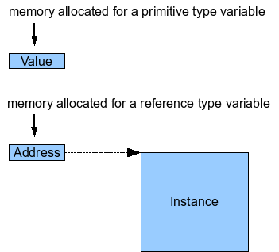
Reference to array
Primitive types
int, long, double, boolean, char, short, byte, float
The actual values are stored in the variable
Reference types
String, int[],…
The value of a reference type variable is an memory address to the variable.
new

Slide 56
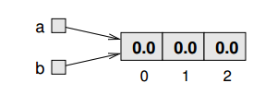
Reference to array
We can assign a different variable to refer to the same array, and we can change the value of counts to refer to a different array.
double[] a = new double[3]; double[] b = a;

Slide 57
Copying arrays
If you actually want to copy the array, not just a reference, you have to create a new array and copy the elements from the old to the new:
double[] a = new double[]{1.5,1.6,1.7};
double[] b = new double[3];
for (int i = 0; i < 3; i++) b[i] = a[i];

Slide 58
Passing arguments
Invoking methods involves passing arguments
There are two ways to pass arguments
Pass-by-value
The value of the argument will be assigned to the parameter of the invoked function.
As a consequence, the invoked function can modify the parameter, but can not modify the argument
Pass-by-reference
The invoked function gets an implicit reference to the argument, rather than a copy of its value.
As a consequence, the function can modify the argument

Slide 59

BMI statistics problem
Input ID, name, height and weight of each student
Calculate the BMI of each student
Sort the student by each attribute in ASCENDING or DESCENDING order
Find the median, mode of the BMIs
Store the above information into a text file
According to the values, divide BMIs into ten same size range, and count the students in each range, lastly print the number of students in each range on the screen
Draw a histogram to show the distribution of the BMIs

Slide 60
public static void sort(double[] items){
int quantity = items.length;
double tmp=0;
for(int i=0;i<quantity;i++)
for(int j=i+1;j<quantity;j++)
if(items[i]>items[j]){
tmp=items[j];
items [j]=items[i];
items [i]=tmp;
}
}
Notes:
返回排序后的下标

Slide 61
Sort students by height
public class BMI{
public static void main(String[] args){
String[] names={“Clinton”,”Obama”,”Trump”,”Bush”};
double[] height={1.88,1.9,1.78,1.76};
sort(height);
for(int i=0;i<sorted.length;i++)
System.out.println( names[i] +”\t”+ height[i]);
}
public static void sort(double[] items){…}
}
Wrong Version!

Slide 62
Sort students by height
public class BMI{
public static void main(String[] args){
String[] names={“Clinton”,”Obama”,”Trump”,”Bush”};
double[] height={1.88,1.9,1.78,1.76};
int[] sorted=sort(height); //using indexes to store the sorted result
for(int i=0;i<sorted.length;i++)
System.out.println( names[sorted[i]] +”\t”+ height[sorted[i]]);
}
public static int[] sort(double[] items){…}
}

Slide 63
public static int[] sort(double[] items){
int quantity = items.length;
int sorted[] = new int[quantity];
int tmp=0;
for(int i=0;i<quantity;i++) sorted[i]=i; //原始数据的下标
for(int i=0;i<quantity;i++)
for(int j=i+1;j<quantity;j++)
if(items[sorted[i]]>items[sorted[j]]){
tmp=sorted[j];
sorted[j]=sorted[i];
sorted[i]=tmp;
}
return sorted;
}
Notes:
返回排序后的下标

Slide 64
BMI statistics problem
Input ID, name, height and weight of each student
Calculate the BMI of each student
Sort the student by each attribute in ASCENDING or DESCENDING order
Find the median, mode of the BMIs
Store the above information into a text file
According to the values, divide BMIs into ten same size range, and count the students in each range, lastly print the number of students in each range on the screen
Draw a histogram to show the distribution of the BMIs

Slide 65
Find the median(中数)
Case 1:
3, 13, 7, 5, 21, 23, 39, 23, 40, 23, 14, 12, 56, 23, 29
When we put these numbers in order we have:
3, 5, 7, 12, 13, 14, 21, 23, 23, 23, 23, 29, 39, 40, 56
The median is 23
Case 2:
3, 5, 7, 12, 13, 14, 21, 23, 23, 23, 23, 29, 40, 56
The median is (21+23)/2= 22

Slide 66
Mode(众数)
The mode of a sample is the element that occurs most often in the collection.
For example, the mode of [1, 3, 6, 6, 6, 6, 7, 7, 17] is 6.
Given the list of data [1, 1, 2, 4, 4] the mode is not unique - the dataset may be said to be bimodal.
while a set with more than two modes may be described as multimodal.
If no number is repeated, then there is no mode for the list.

Slide 67
Find the mode
Algorithm for finding mode:
Step1: Count each unique element
Step1.1: find the unique elements
Step1.2: Count the elements
Step2: find the element that occurs most often
Step2.1: Find the maximum number of occurrences
Step2.2: Output the mode
Case1: no mode (each element only occur one time)
Case2: output the mode (elements whose occur number equals the max count number)

Slide 68
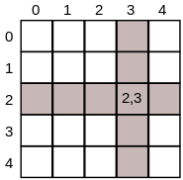
Two-dimensional Array(二维数组)
Two-dimensional arrays are also sometimes called matrices. They work in much the same way as a one-dimensional array but allow you to specify a column index and a row index.
For example, if A is a 2D array of int, then A[2][3] would be the element in row 2, column 3.

Slide 69
Create and initialize 2D Array
Create a 2D array
int[][] A = new int[3][4];
Create and initialize a 2D array
int[][] A = new int[][] {
{ 1, 0, 12, -1 },
{ 7, -3, 2, 5 },
{ -5, -2, 2, -9 }};
int a[][] = { { 1 }, { 3, 4 }, { 5, 6, 7 }, { 9, 10, 11, 12 } };

Slide 70
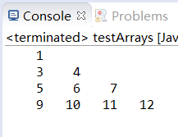
Print 2D array
int a[][] = { { 1 }, { 3, 4 }, { 5, 6, 7 }, { 9, 10, 11, 12 } };
for (int i = 0; i < a.length; i++) {
for (int j = 0; j < a[i].length; j++) {
System.out.printf("%5d", a[i][j]);
}
System.out.println();
}

Slide 71
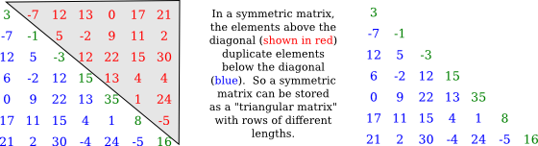
Triangular array(三角形数组)
A symmetric matrix, M, is a two-dimensional array satisfying M[i][j] equals M[j][i] for all i and j. Because of this equality, we only really need to store M[i][j] for i >= j.

Slide 72
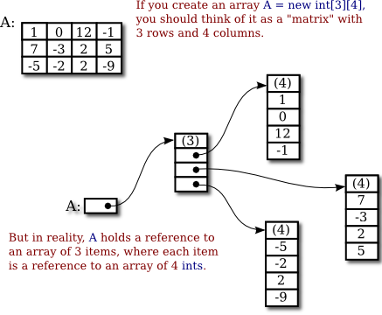
Behind the 2D array
Remember that a variable of type int[] can only hold a pointer to an array of int.
So, a 2D array is really an array of pointers, where each pointer can refer to a one-dimensional array.

Slide 73


